Slide 1
Angular 4
Created By:
Accums UI Team

Slide 2
Agenda
What is Angular js and it’s key Feature
Dependency: Node js and Angular cli
How to start with angular js project
Modules, Components, Services, Directive and Types of Directive
Data Binding
Accums UI Demo

Slide 3
What is Angular and It’s Key Feature
Angular is a JavaScript/typescript framework used to create reactive single page application.
Key Features:
Modular Approach
Hierarchical and dependency Injection
Speed and Performance
Provides Two Way Data Binding

Slide 4
Dependency: Node JS & Angular cli
Node Js: It is a pre-built installer for your platform.
Angular Cli: Angular cli is a command line interface to build angular apps using nodejs modules. Not only it provides you scalable project structure, instead it handles all common tedious tasks for you out of the box.
Supported IDE: Visual studio or visual studio code or eclipse ide supports AngularJs.

Slide 5
How to start with angular js Application
There are few commands to start with angular application
1. npm install -g @angular/cli (Used to install angular cli globally)
2. ng new my-app ( To create new project. My-app is app name)
3. cd my-app (to go inside that app folder)
4. npm install ( To install all basic package for angular app)
4. ng serve –-port 9001 or ng serve ( launches the server)

Slide 6
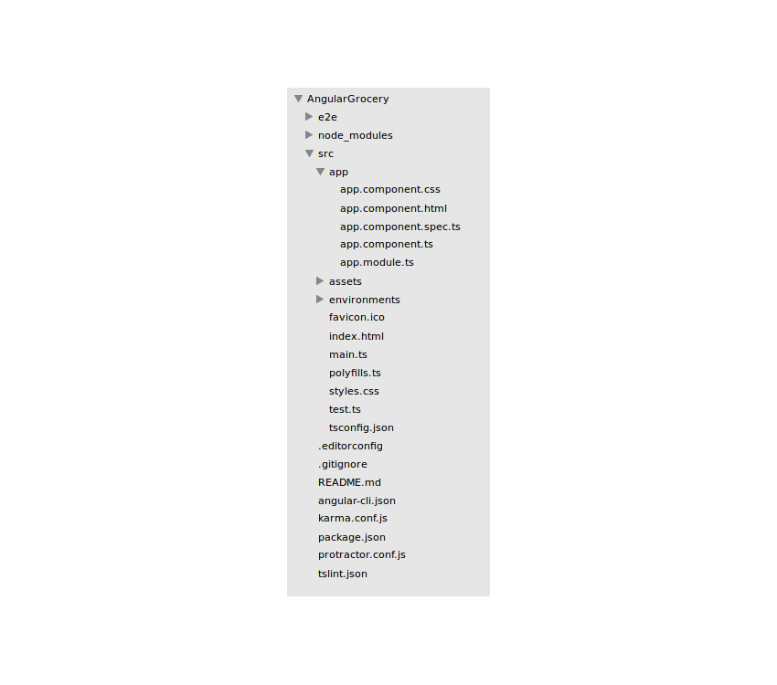
Project Structure

Slide 7
Modules:
It is a Cohesive block of components, directives, services and pipes.
Decorator: @NgModule
Example:
import { NgModule } from '@angular/core';
import { BrowserModule } from '@angular/platform-browser';
@NgModule({
imports: [ BrowserModule ],
providers: [ Logger ],
declarations: [ AppComponent ],
exports: [ AppComponent ],
bootstrap: [ AppComponent ]
})
export class AppModule { }

Slide 8
Components:
Component contains your business logic and controls your view/template. A component is a directive-with-a-template
Decorator: @Component
Example:
@Component({
selector: 'app-hero-list',
templateUrl: './hero-list.component.html',
styleUrls: ['./hero.component.css']
providers: [ HeroService ]
})
export class HeroListComponent implements OnInit { /* . . . */ }

Slide 9
Services:
It is used to share data across components. All server side interaction logic we keep in service.
Service's are singleton object in typescript.
Example:
export class GlobalService {
constructor(private httpClient : Http) { }
public getRequest ( requestUrl : string ) : Observable<any> {
return this.httpClient.get(requestUrl)
.map(response => this.handleResponse(response))
.catch(error => this.handleError(error))
}
public postRequest<T> (requestUrl : string, postBody : T) : Observable<any> {
return this.httpClient.post(requestUrl, postBody)
.map(response => this.handleResponse(response))
.catch(error => this.handleError(error))
} }

Slide 10
Directive:
A Directive is a component without a template.
Example: ngStyle, ngClass, ngFor etc.
Types of Directive:
Attribute Directive: change the appearance and behavior of an element. Eg – NgStyle
Structure Directive: – change the DOM layout by adding and removing DOM elements. Eg – NgFor, NgIf

Slide 11
Types of Data Binding:
Interpolation: Use {{ }} to show component data in to template
Property Binding: Use to bind data to property of element or to pass data from parent component to child component. Ex: [readonly]=“true”
Event Binding: Use to bind data to event Ex: (click)=“Login()”
Two Way Binding: To bind data from component to template and vice versa

Slide 12
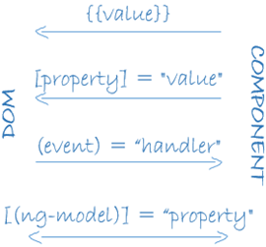
Data Binding

Slide 13
Any Queries ?

